Slide 1
Usage of SimpleITK

Slide 2

A simplified version of ITK (Insight Tool Kit) for scientific image processing, segmentation, and registration
Ideal for medical imaging: X-rays, CT, PET, MRI, and US
Available in Python:
pip install SimpleITK | conda install simpleitk

Slide 3
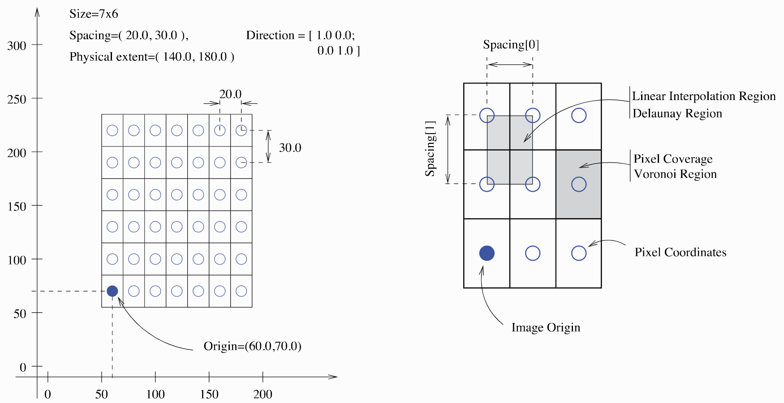
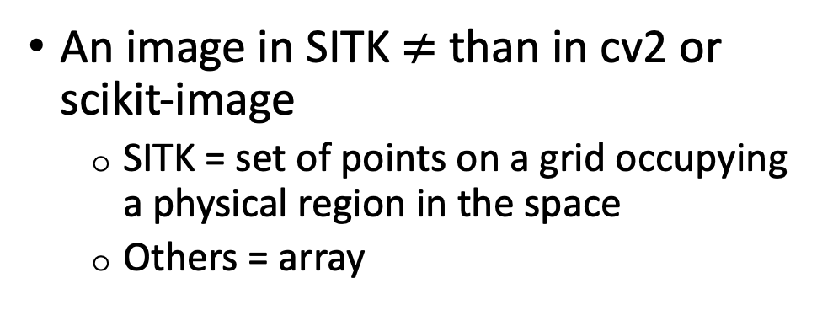
Image fundamentals
An image in SITK $≠$ than in cv2 or scikit-image
SITK = set of points on a grid occupying a physical region in the space
Others = array
SITK takes into account:
Pixel/voxel spacing information
Location in the physical space

Slide 4
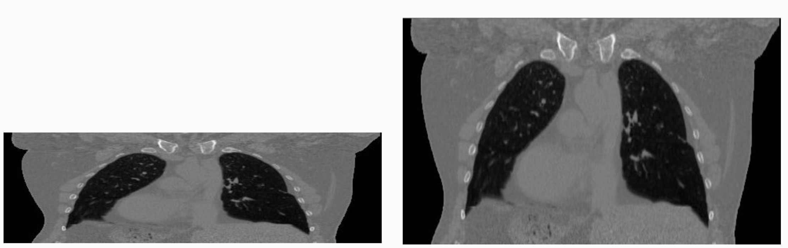
Image spacing:
256
256
512
512
Image spacing = (1.0, 1.0)
Image spacing = (0.97, 2.0)

Slide 5
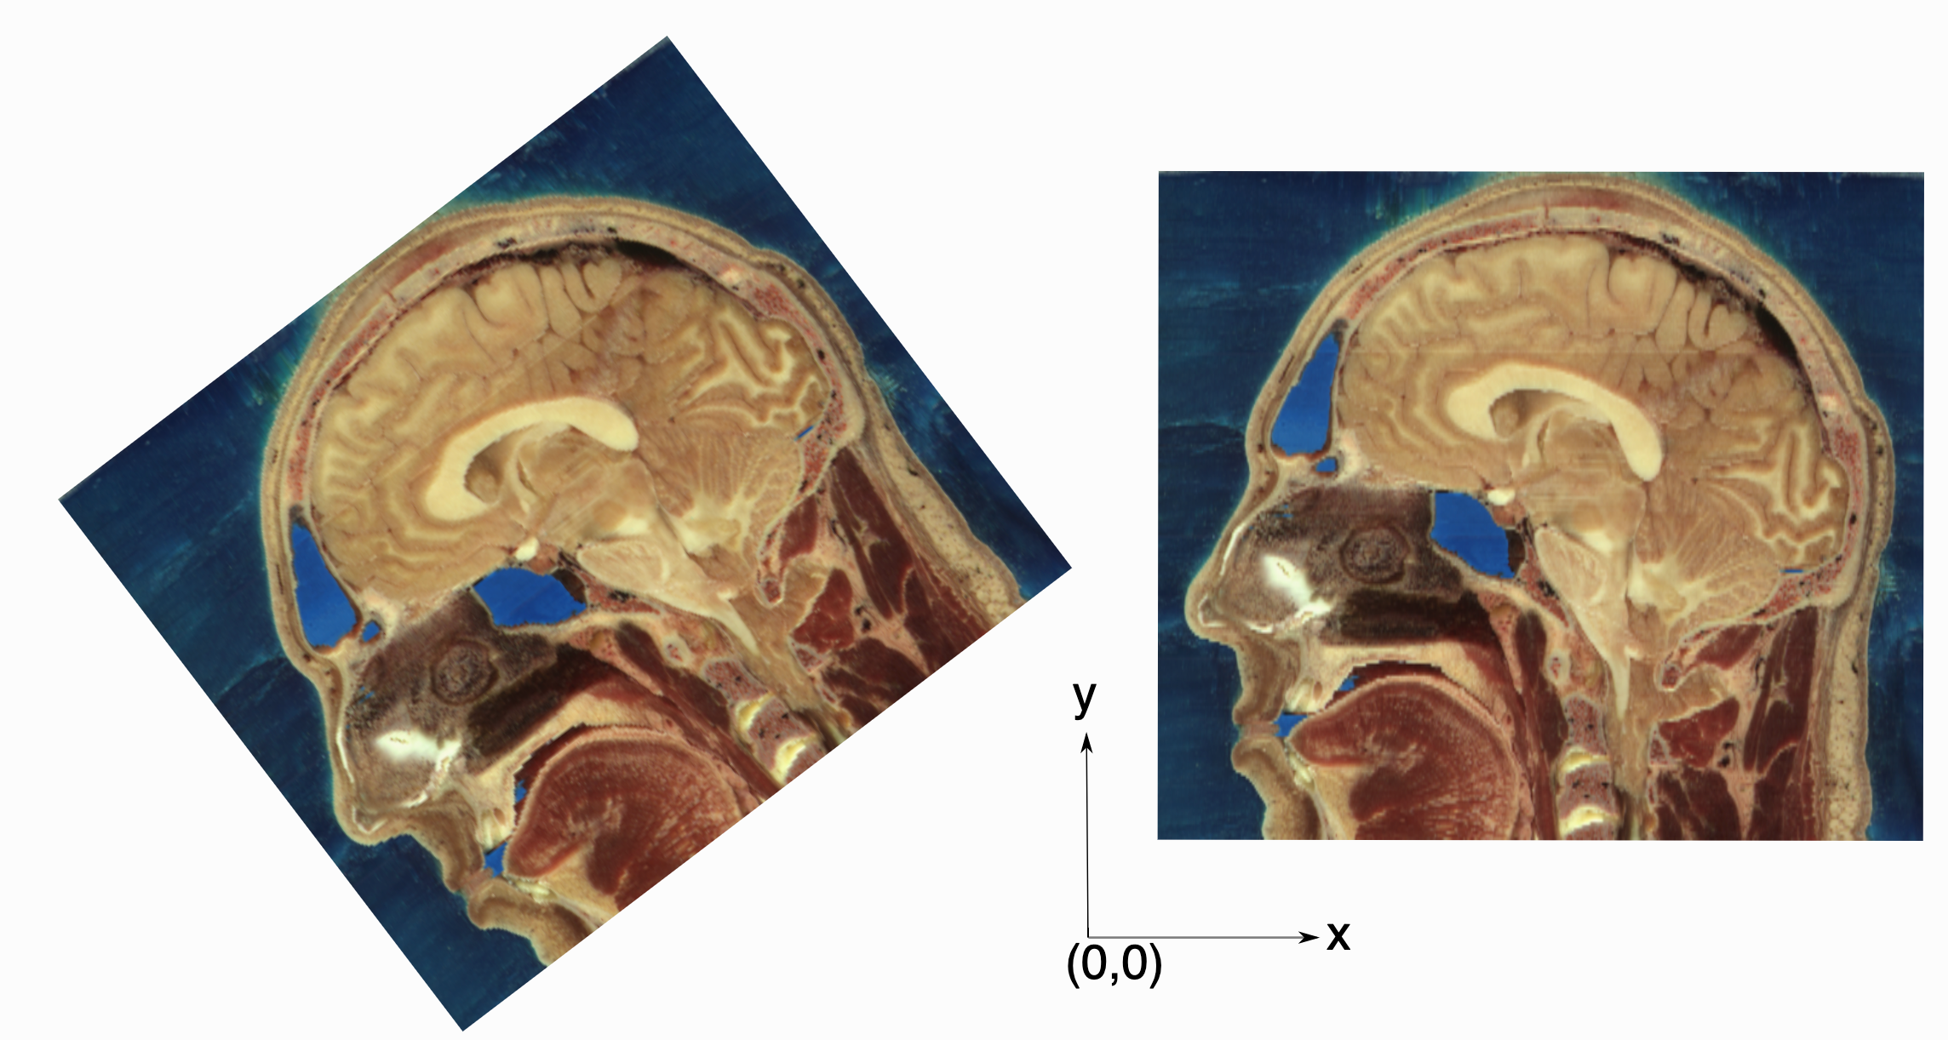
Image origin and direction:
Image origin = (-136.3, -20.5)
Orientation matrix = (0.7, -0.7, 0.7, -0.7)
Image origin = (16.9, 21.4)
Orientation matrix = (1, 0, 0, 1)

Slide 6
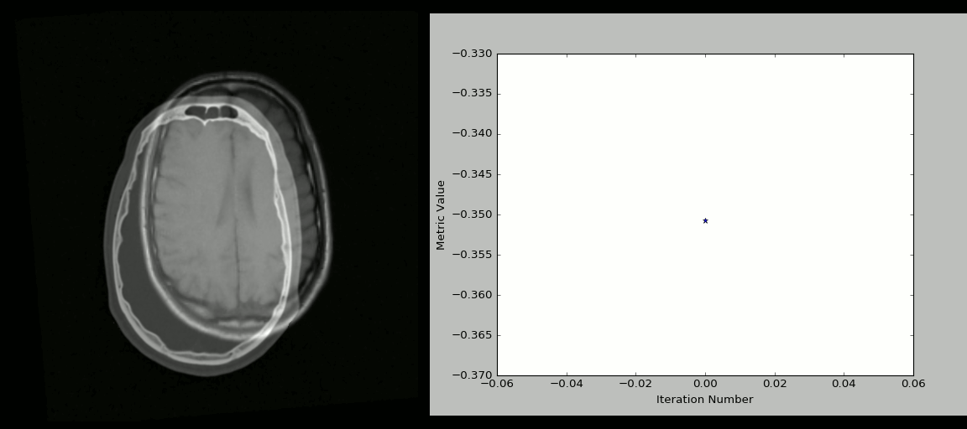
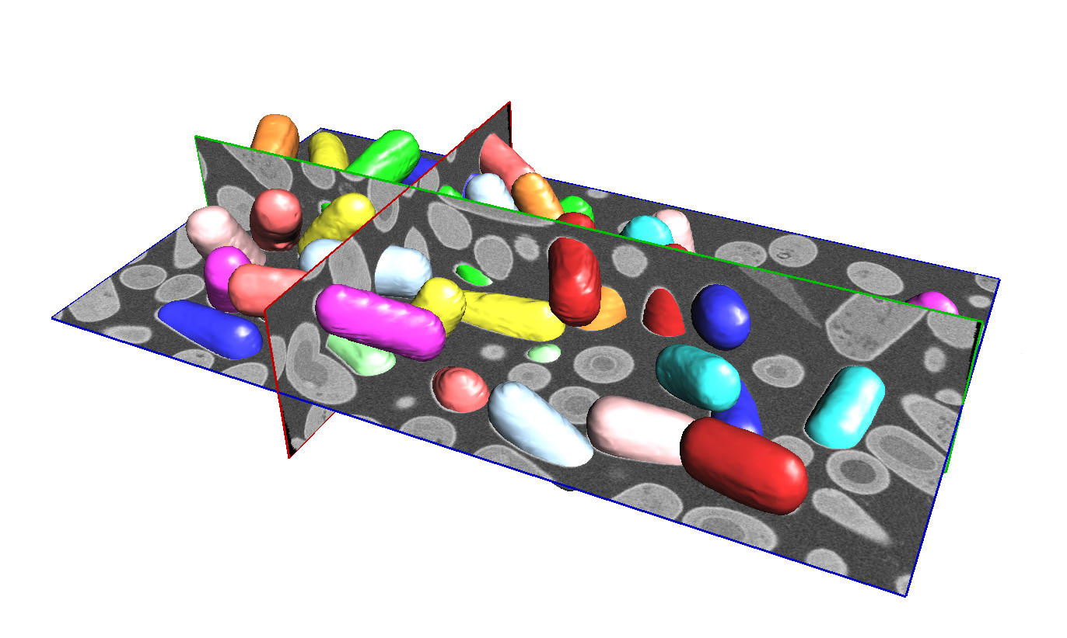
Image registration:
Image segmentation:

Slide 7
How to read an image?
import SimpleITK as sitk
image = sitk.ReadImage(path_to_image)

Slide 8
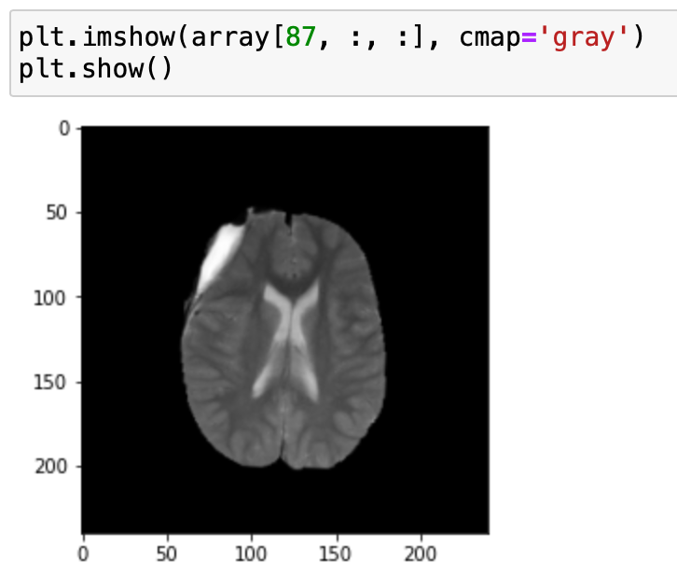
Conversion between SimpleITK and NumPy
From SimpleITK to NumPy:
image = sitk.ReadImage(path_to_image)
array = sitk.GetArrayFromImage(image)
array.shape -> (155, 240, 240)

Slide 9
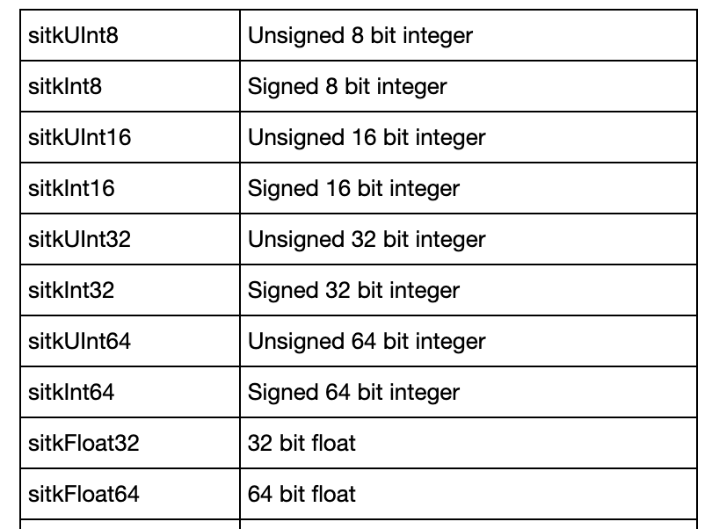
Reading an image
Multiple image formats:
Standard ones: .jpeg, .png, .tiff, etc
Medical ones: .mha, .nii, .dcm
image = sitk.ReadImage(path_to_image)
Default = '16-bit signed integer’
image = sitk.ReadImage(path_to_image, sitk.sitkUInt8)

Slide 10
Practical Session 3
Image enhancement and denoising

Slide 11
Exercise 1: Image histogram
Linear stretching *
Histogram equalization *
CLAHE (skimage implementation)

Slide 12
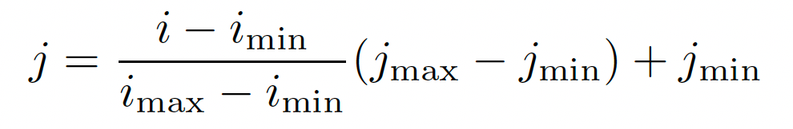
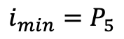
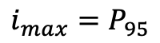
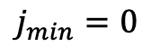
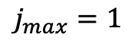
Exercise 1: Image histogram
Linear stretching *
$j_{min}=0$
$j_{max}=1$
$i_{min}=P_{5}$
$i_{max}=P_{95}$

Slide 13
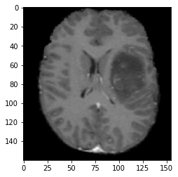
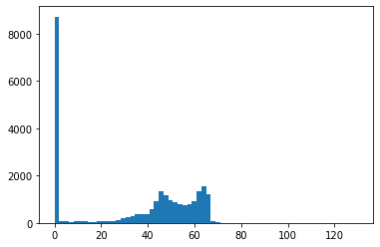
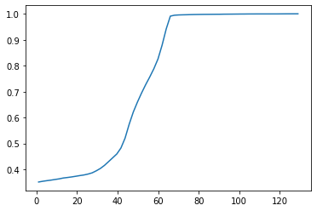
Exercise 1: Image histogram
Histogram equalization*
Scaled cumulative
distribution
Bins centers

Slide 14
Exercise 1: Image histogram
Histogram equalization*
Interpolate

Slide 15
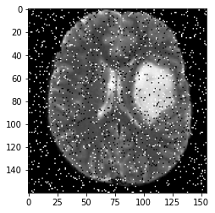

Exercise 2: Image denoising
Gaussian filter
Median filter
Mean filter *

Slide 16
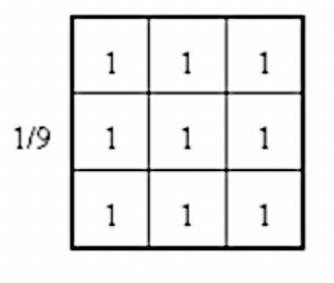
Exercise 2: Image denoising
Mean filter *
Convolve

Slide 17
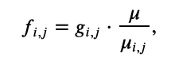
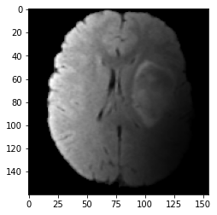
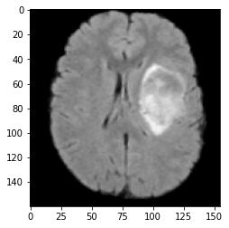
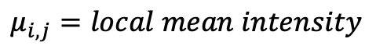
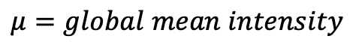
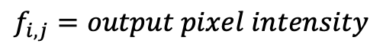
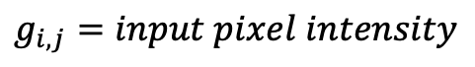
Exercise 3: HUM algorithm
Remove bias noise
$$f_{i, j}=output pixel intensity$$
$$μ=global mean intensity$$
$$g_{i, j}=input pixel intensity$$
$$μ_{i,j}=local mean intensity$$

Slide 18
Exercise 3: HUM algorithm
Direct implementation:
Get mean intensity (global)
Define a window of 40 x 40
Get mean intensity (local)
Compute HUM
Move the window, and repeat
40
40

Slide 19
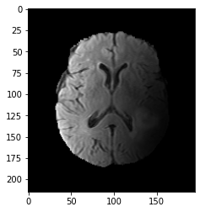
Exercise 3: HUM algorithm
Pad image:
Pad the image
Get mean intensity (global)
Define a window of 40 x 40
Get mean intensity (local)
Compute HUM
Move the window, and repeat
40
40

Slide 20
Exercise 3: HUM algorithm
Pad + threshold:
Pad the image
Filter pixels below a threshold (10)
Get mean intensity (global)
Define a window of 40 x 40
Get mean intensity (local)
Compute HUM
Move the window, and repeat
40
40

